Slide 1

AURA
Assembly of University research administrators
November 15, 2022
Sponsored Projects Administration

Slide 2
AGENDA
New Staff Introductions Kathleen Kreidler
Conflict of Interest Module in START Valerie Bomben & Vyju Ram
Budgeting Clinical Trial Revenue in FMS Kathleen Kreidler
Max/Min Effort Waiver Form Hung Huynh
Committed Effort Reminders
CPRIT Updates-NCEs, Tuition, Travel, Budgeting Carmen Martinez
START – Eliminating Child Submissions Kathleen Kreidler

Slide 3
NEW STAFF INTRODUCTIONS

Slide 4
New staff introductions
  If this is your first AURA meeting:
  Unmute yourself, turn on your camera, and please tell us
  your name
  department
  role/title
  anything else you’d like to share

Slide 5
Conflict of interest module in start

Slide 6
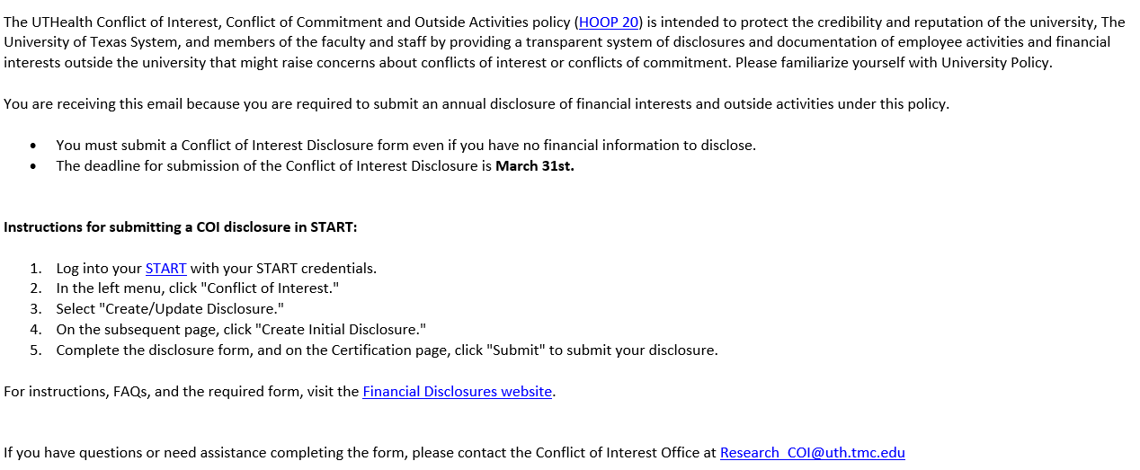
Conflict of interest module in start

Slide 7
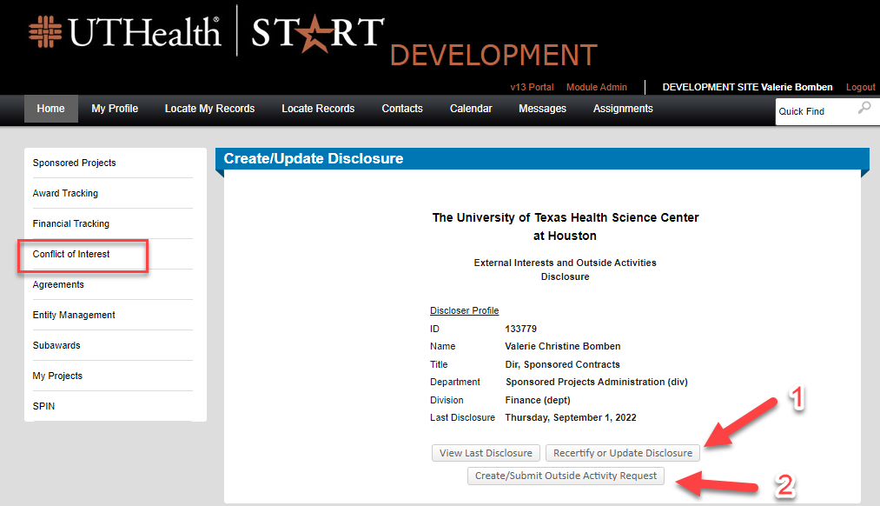
Conflict of interest module in start

Slide 8
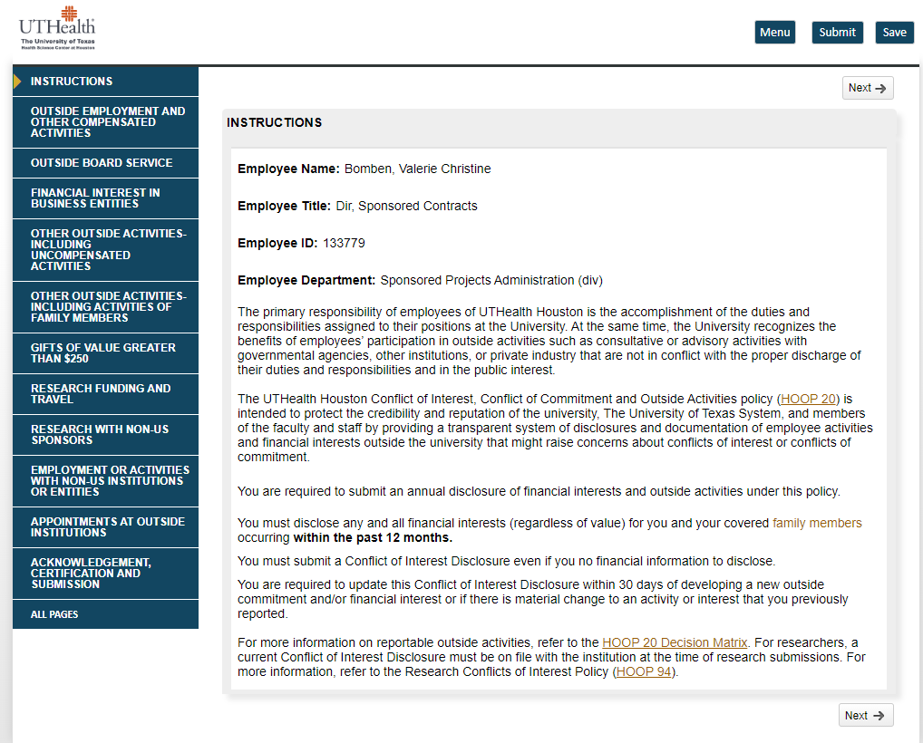
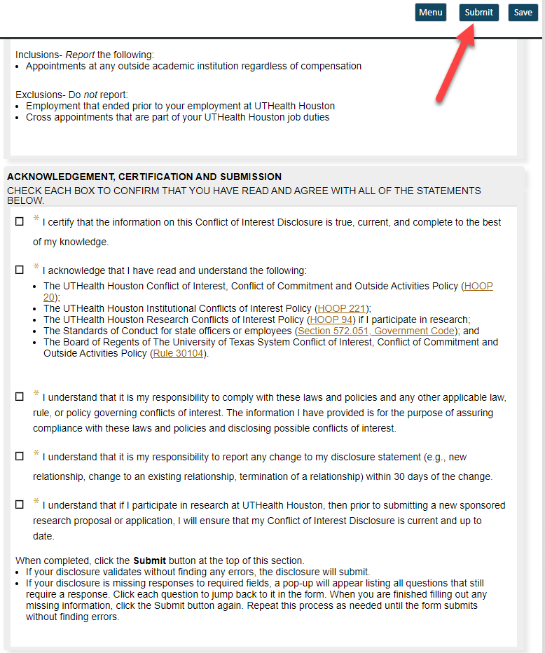
Conflict of interest module in start

Slide 9
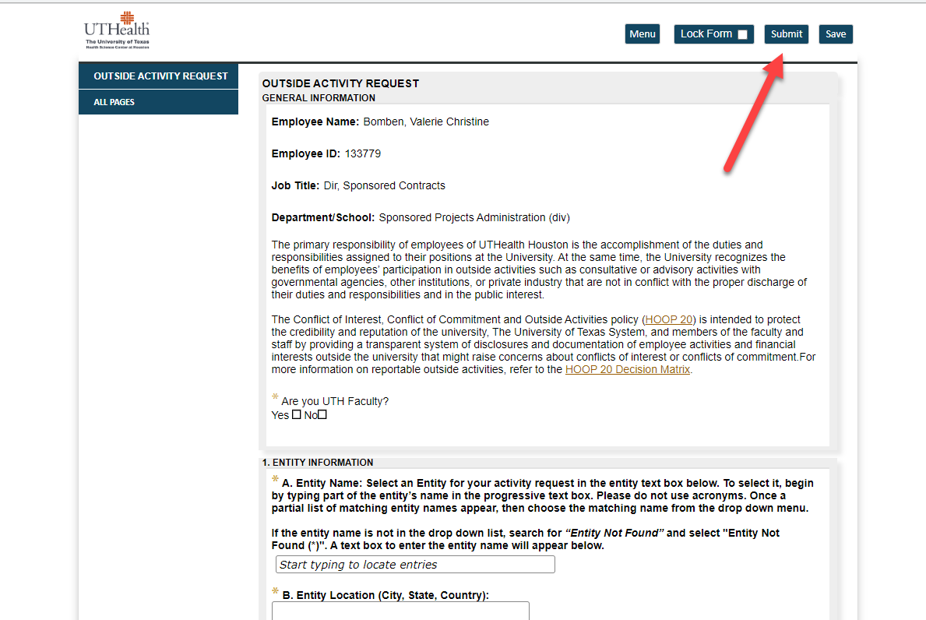
Conflict of interest module in start

Slide 10
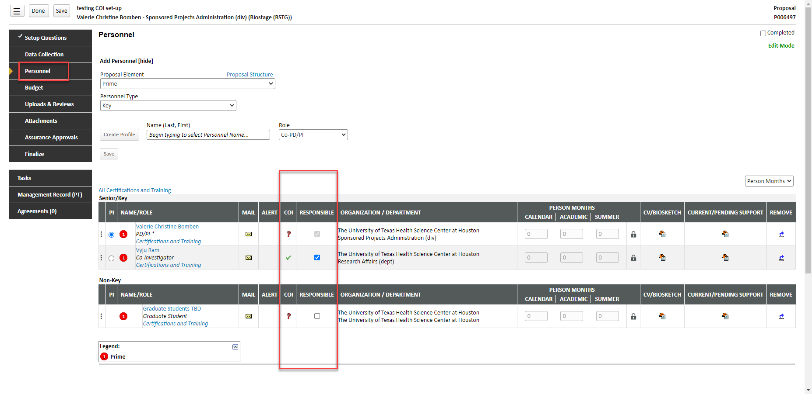
Conflict of interest module in start

Slide 11
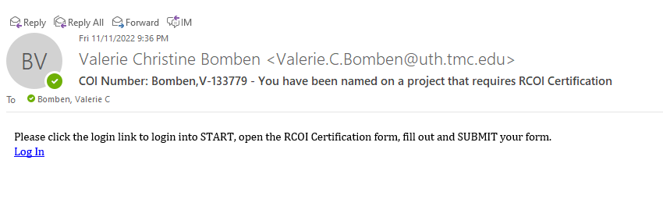
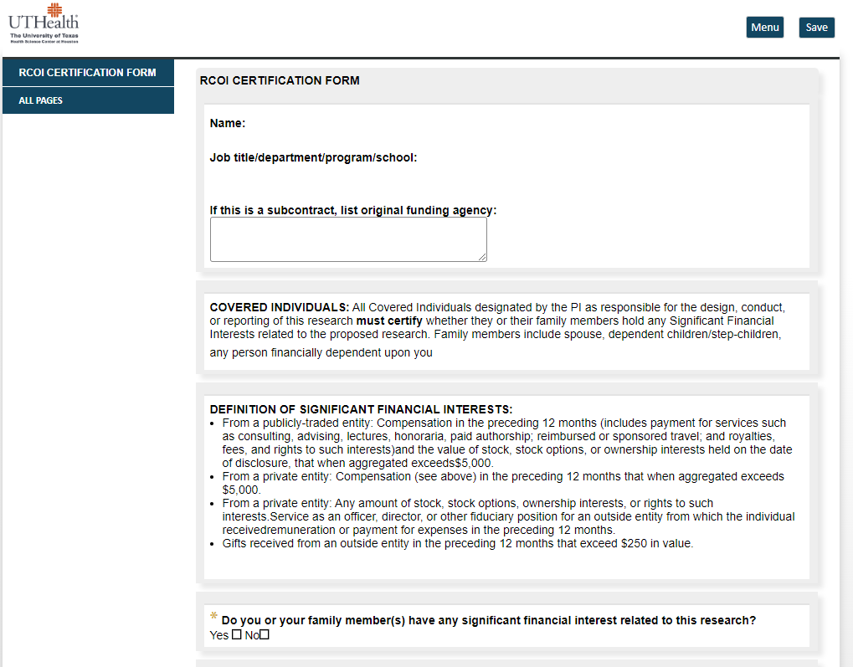
Conflict of interest module in start

Slide 12
Budgeting clinical trial revenue in fms

Slide 13
Budgeting clinical trial revenue in fms
PAF receives ~200 check and wire deposits each month including about 80 for industry clinical trials:
  Identify the correct project # (locate remittance advice if received)
      contact sender for more detail for those PAF cannot identify
  Calculate DC/IDC split
  Code CFS and post budget and revenue
      all DC is budgeted to 61006 (M&O)

Slide 14
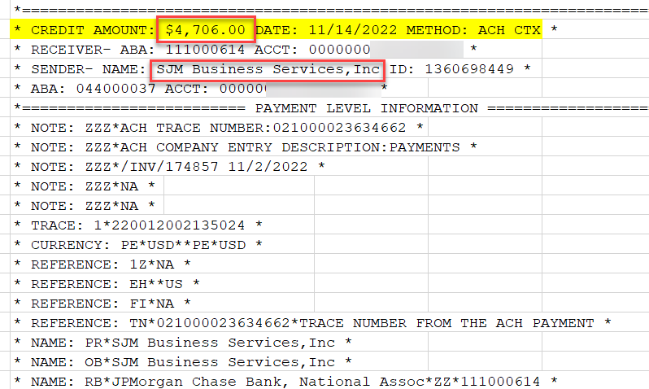
Budgeting clinical trial revenue in fms
Wire transfers are harder to identify due to limited information received.

Slide 15
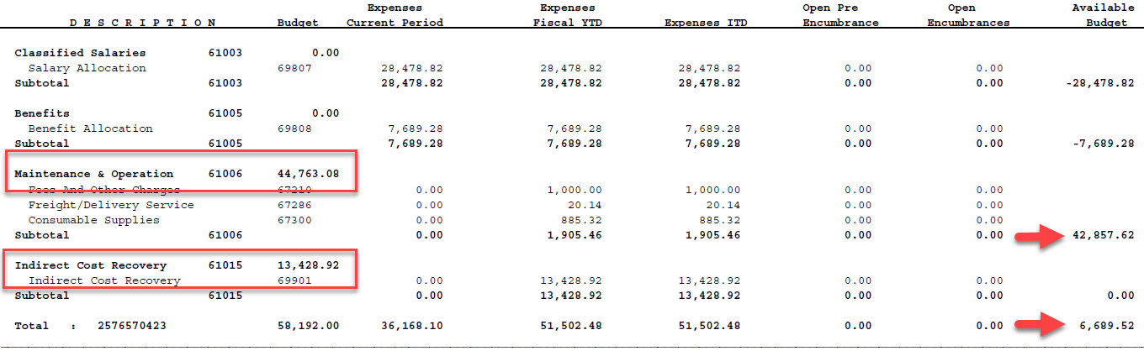
Budgeting clinical trial revenue in fms
Potential to overspend overall budget due to availability of M&O budget. Be sure to review your accounts and rebudget.

Slide 16
Max/min effort waiver form

Slide 17
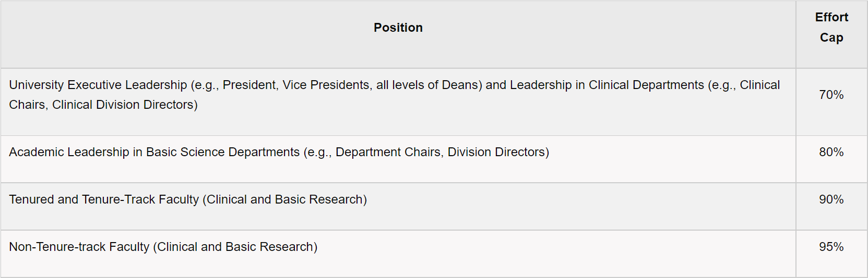
Minimum and maximum effort commitment
Minimum Level of Committed Effort - The required minimum level of committed effort listed for Primary Individuals on each sponsored project is 2%.
Maximum Level of Committed Effort – Depends on the Primary Individual’s position at the University.

Slide 18
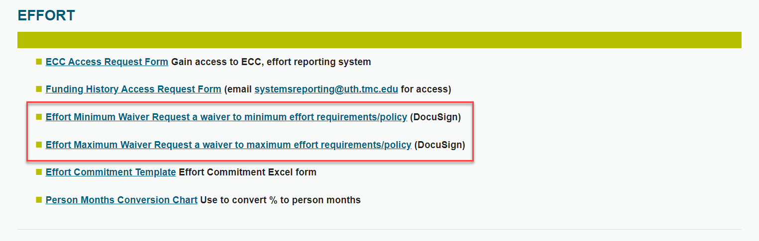
Where to find Effort Waivers?
https://www.uth.edu/sponsored-projects-administration/tools-resources/forms-templates

Slide 19
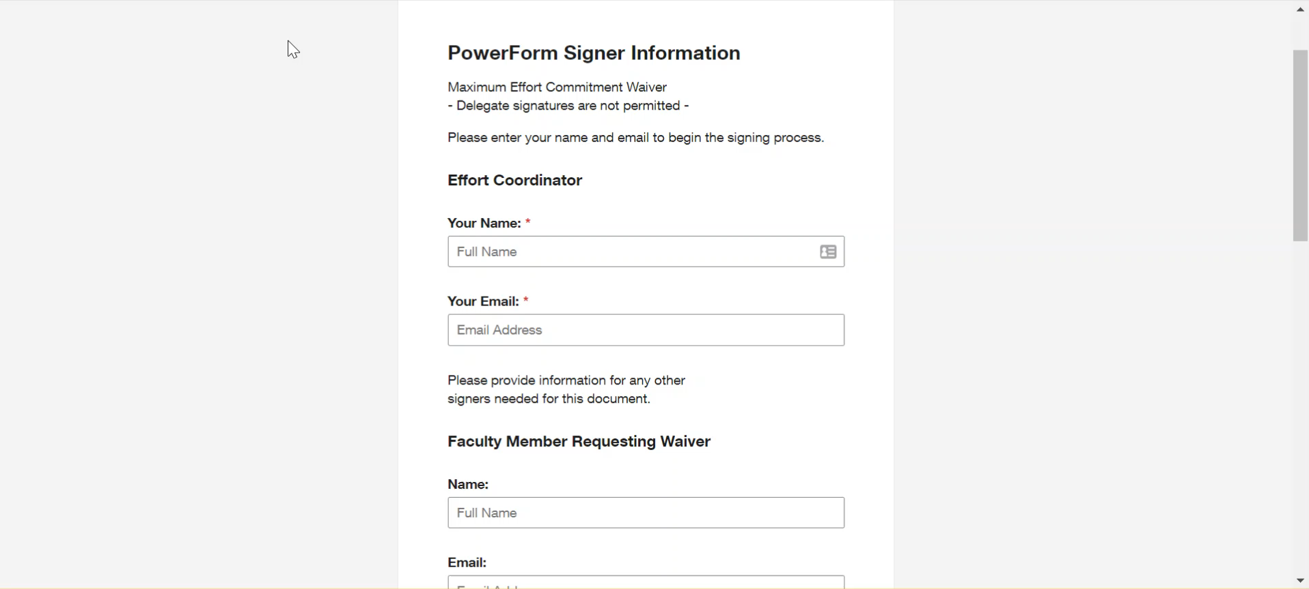

Slide 20
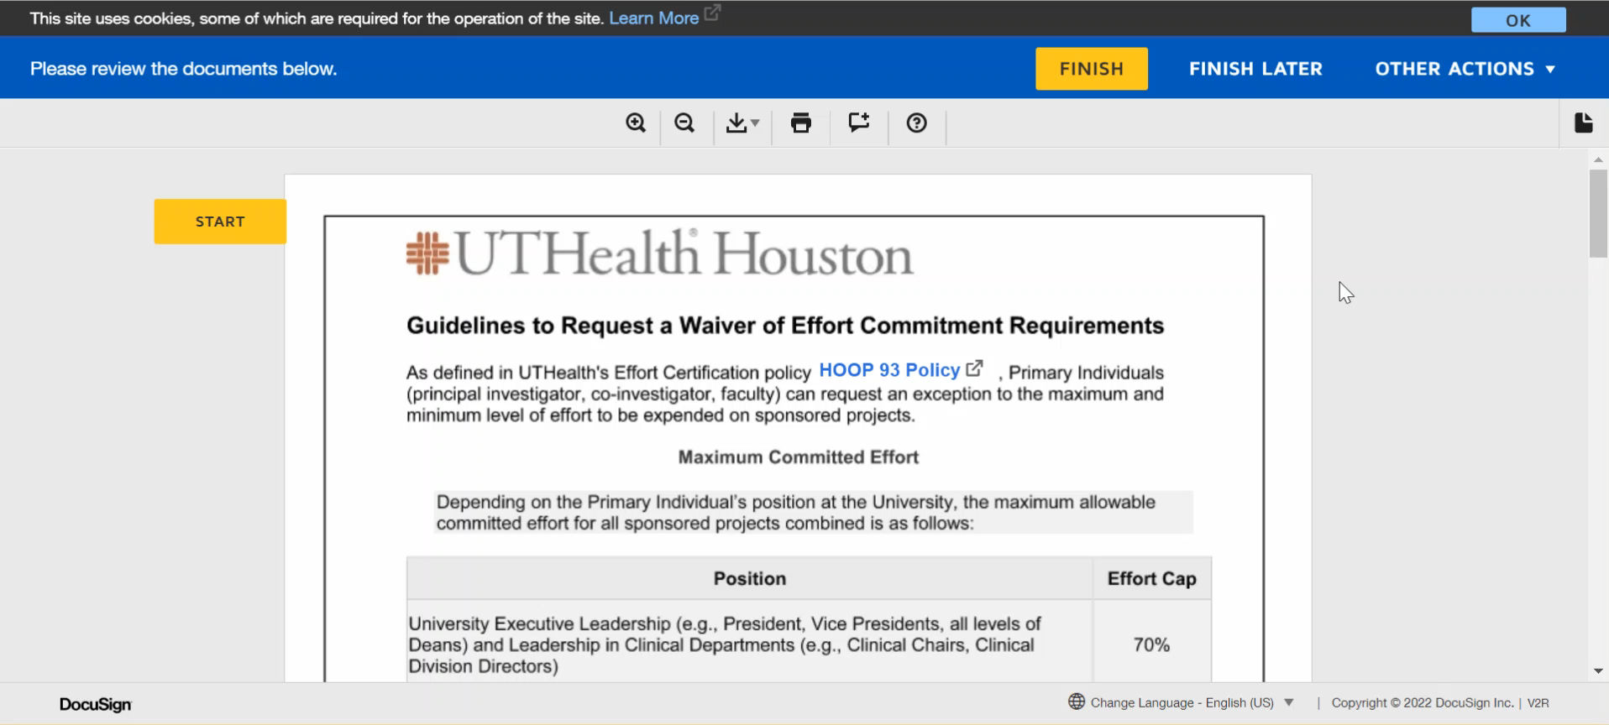

Slide 21
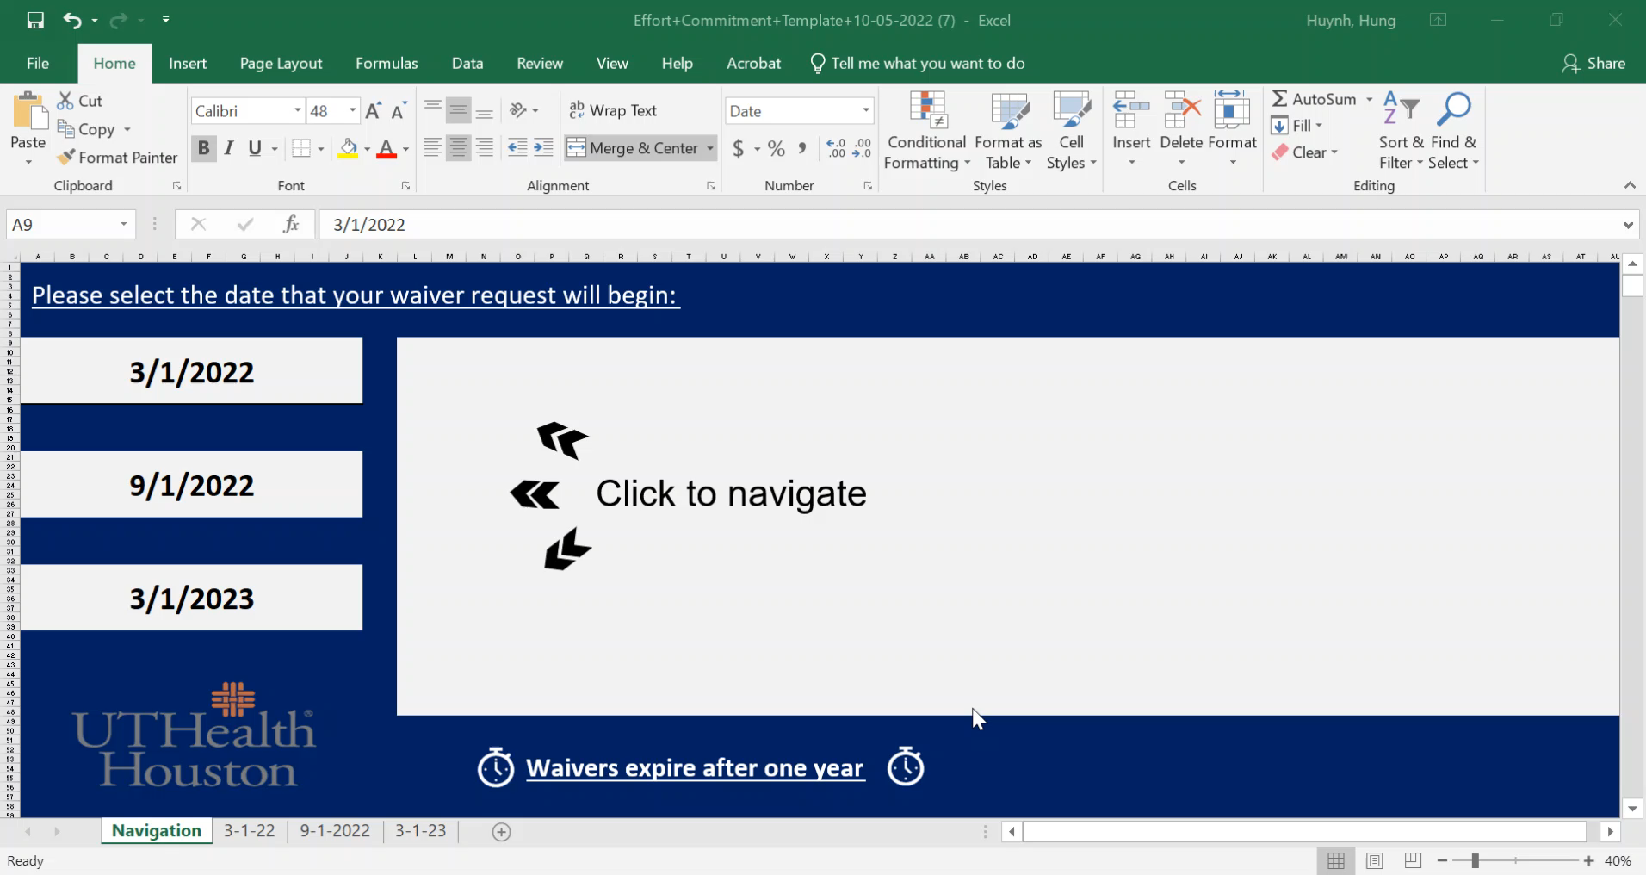

Slide 22
Effort Waiver Deadlines
March – August 2022 will be accepted until December 12, 2022 (End of Certification period).
September 2022 – March 2023 will be accepted until December 31, 2022.
After December 31, you must submit a waiver before or within the first 60 days of each period of performance.

Slide 23
Common Causes for Committed Effort Errors
START records are not up-to-date
Child submissions
NCE period
START
ECC

Slide 24
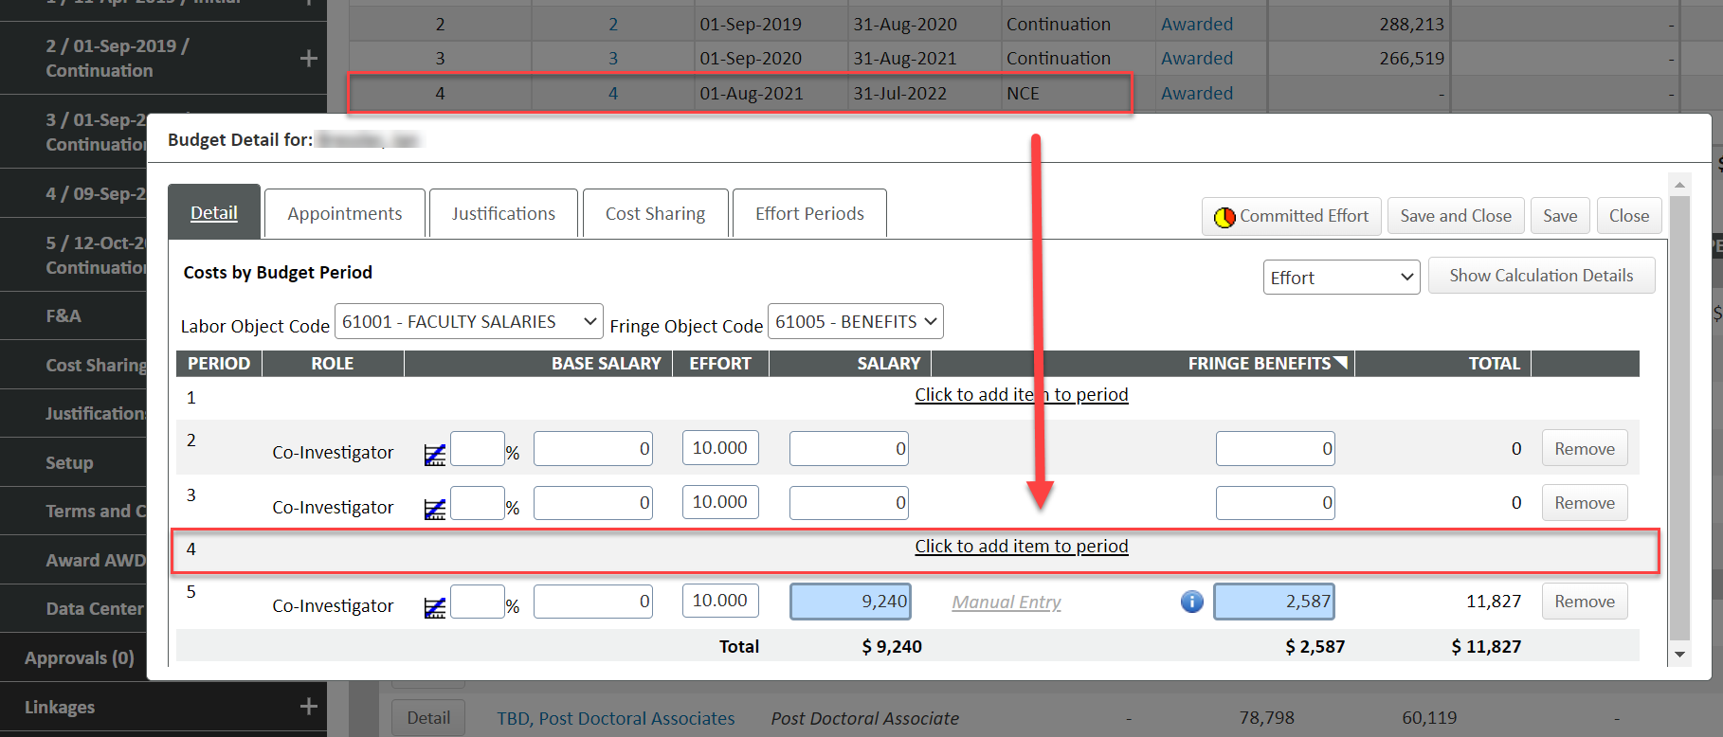
Effort Commitment Errors
Only SPA staff can adjust effort on an award. Please notify your SPA specialist when you see an error in committed effort.

Slide 25
Cprit updates

Slide 26
Cprit updates
NCEs can now be requested for 12 month periods
  Must be submitted at least 30 days prior to award end date
  PI needs to have measurable effort
  Grantee must be in good financial and programmatic standing
  PLOEs must be submitted to include personnel effort with the NCE Request

Slide 27
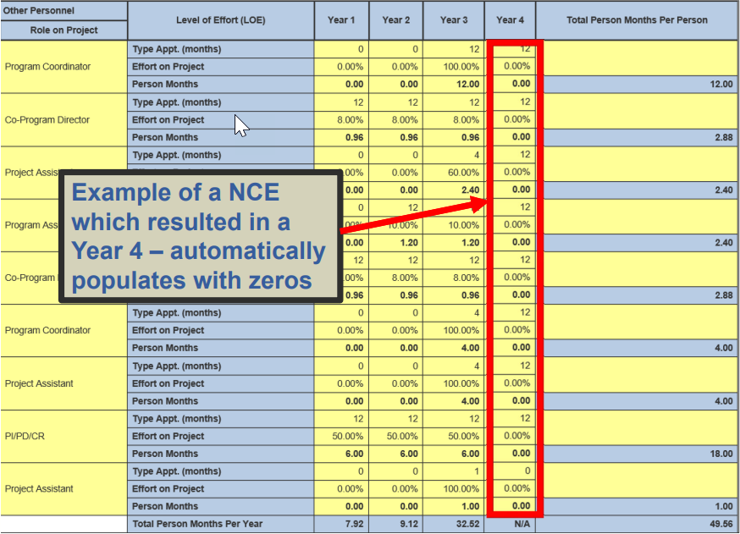
CPRIT Updates

Slide 28
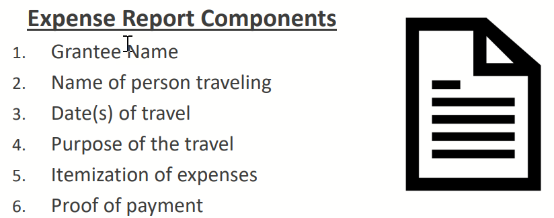
Cprit updates
Tuition
  Tuition can be charged to award if student is allocated to the project
  Student must be listed on the PLOE
Travel
  All travelers must be listed on PLOE
  Separate expense report should be submitted for each trip taken

Slide 29
Cprit updates
Travel cont.
  Meals reimbursed by itemized receipt (unless using per diem)
  Exclude group meals, gratuities and alcohol
  Meals and lodging expenses are within GSA limits
  Taxi/Uber/Lyft receipts are included minus gratuities
  International travel must be pre-approved
    Listed on initial budget justification or
    Submit a Change Not Otherwise Specified

Slide 30
Cprit updates
Budgeting Reminders
  Any changes to approved budget must be submitted through “Rebudgeting Change Request”
  Requests <10% are auto approved except for equipment purchases

Slide 31
Start – eliminating child submissions

Slide 32
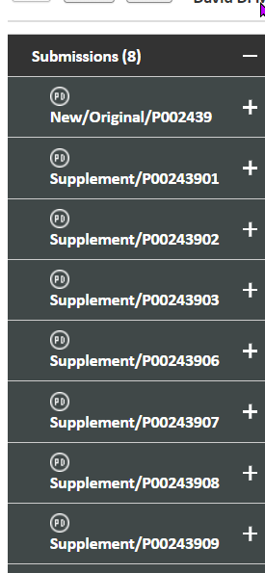
Start – eliminating child submissions
Since START was implemented, we have used the parent-child submission process where all associated proposals submissions are housed on the same record.
We’ve learned there are more cons than pros with child submissions.
Parent Submission
Child Submission

Slide 33
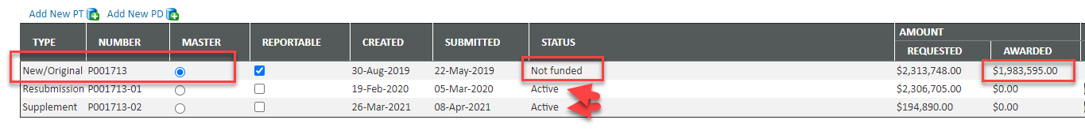
Start – eliminating child submissions
Can’t tell which proposals were awarded and for how much since all awards roll up to the parent.
System creates numerous subawards in error when awarding a child submission.
Difficult to navigate and attach items in the right place.
Committed effort on child submissions does not extract properly from START to load into effort system.

Slide 34
Start – eliminating child submissions
Effective 12/5/22 – Each proposal submission will be submitted with a separate record number and will be it’s own master.
    All renewals, resubmissions, supplements will be linked on the Data Collection Form.
    View via the Linkages tab

Slide 35
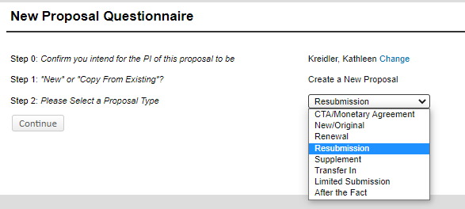
Start – eliminating child submissions
How you create the proposal will not change. Still select the proper proposal type.
No requirement to link to the Parent Submission.
No 2-digit extension on the project number.

Slide 36
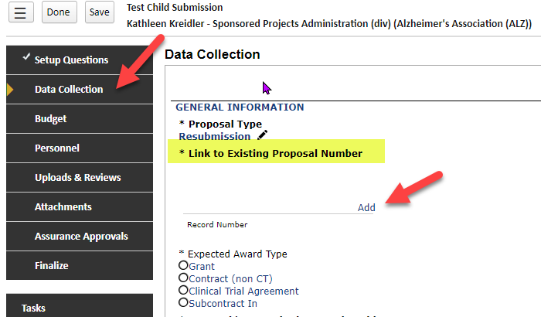
Start – eliminating child submissions
The linkage will now occur on the
Data Collection Form

Slide 37
Start – eliminating child submissions
Transition of Pending Child Submissions that are awarded:
    SPA will identify records where a child submission is newly awarded or guarantee requested.
    SPA will make the child submission it’s own master record and will link it to the original parent record.
    The new master record will retain the child submission record number (e.g P00123401) but only one submission will exist per record.
    A note will be added in submission history explaining the master/child relationship has been broken on the record.

Slide 38
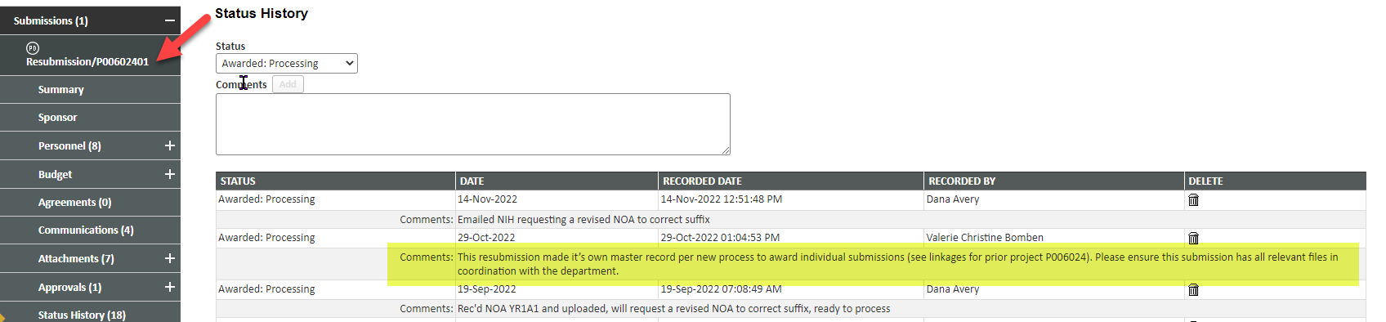
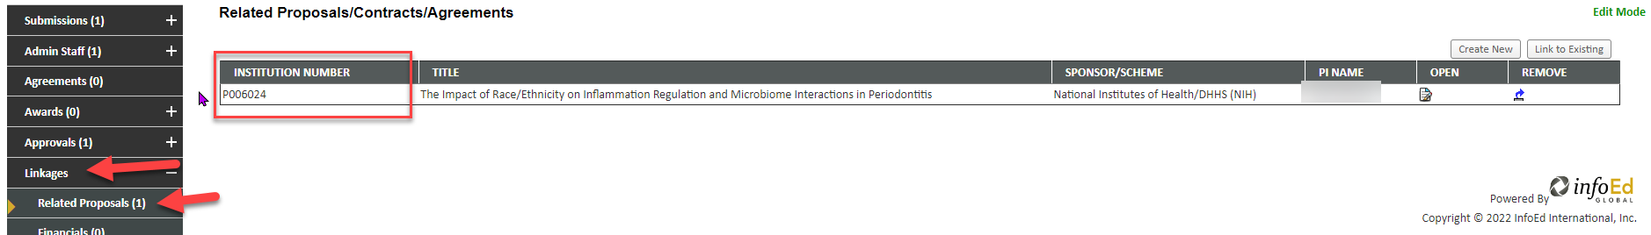
Start – eliminating child submissions

Slide 39
Q & A

